Slide 1
Power point by Ana Real Tirador. November 2020
Resources from http://resources.hwb.wales.gov.uk/VTC/nursery_rhymes/eng/Introduction/default.htm,
Twinkl and YouTube

Slide 3
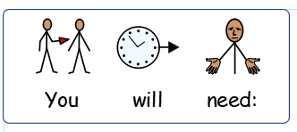
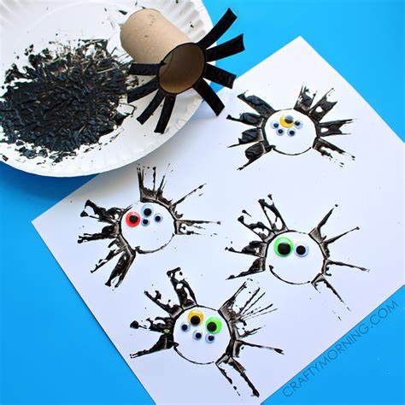

Slide 4
