Slide 2
Click the screen to see the fireworks.
Notes:
If you are using an earlier version of PowerPoint you will need to click on the video for it to play. It might take a few seconds to load.

Slide 3
Click the screen to see the fireworks.
Notes:
If you are using an earlier version of PowerPoint you will need to click on the video for it to play. It might take a few seconds to load.

Slide 4
Click the screen to see the fireworks.
Notes:
If you are using an earlier version of PowerPoint you will need to click on the video for it to play. It might take a few seconds to load.

Slide 5
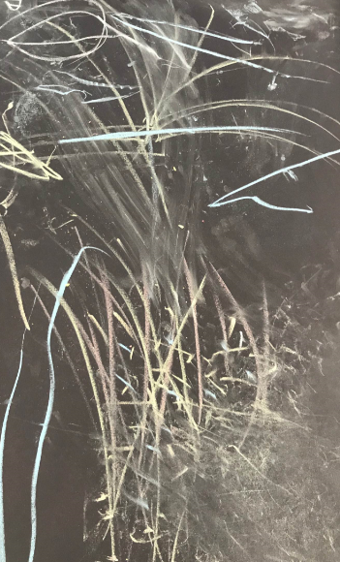
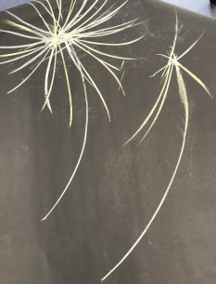
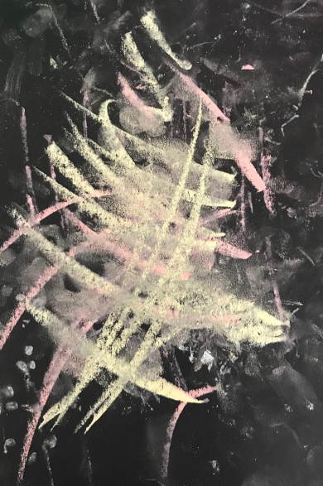
Use some black paper and chalks and make some fireworks

Slide 7
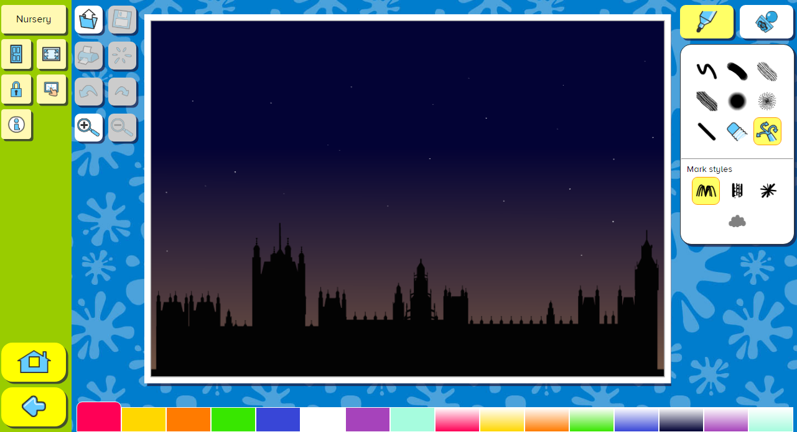
Click here to access Busy Things
Login in as pupil. Nursery. Special events. Firework display. Bonfire night.

