Slide 1

Click here to see a poppy animation

Slide 2
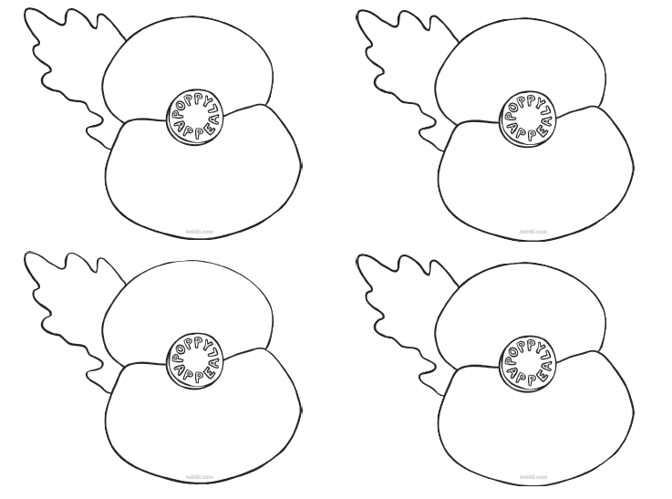
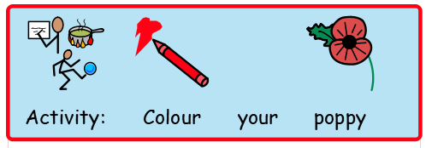
Ask an adult to draw a poppy for you. Colour it using red colour.

Slide 3
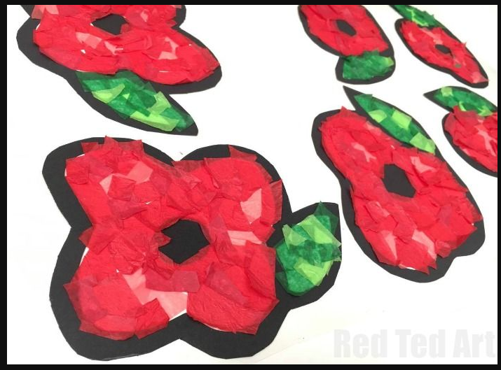
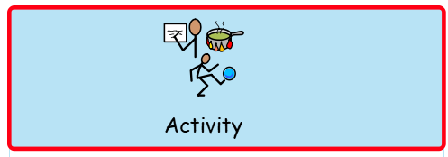
Tear some red and green paper and paste it on a poppy picture to make a beautiful poppy at home.

