Slide 1
Click here to see a poppy animation

Slide 2
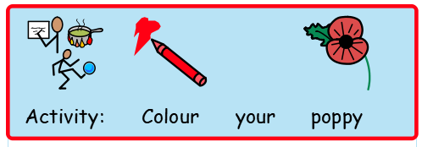
Ask an adult to draw a poppy for you. Colour it using red colour.

Slide 3
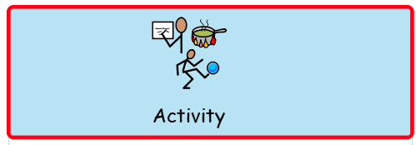
Tear some red and green paper and paste it on a poppy picture to make a beautiful poppy at home.

