Slide 1
The Christmas Story
Lindon Bennet School

Slide 2
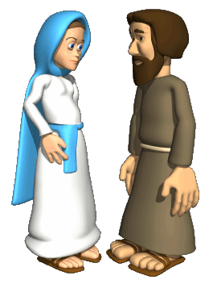
A long time ago, far away lived Mary and Joseph

Slide 3
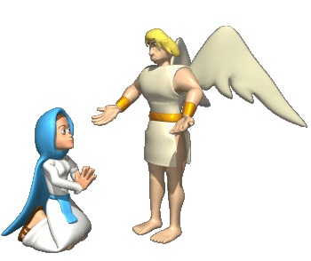
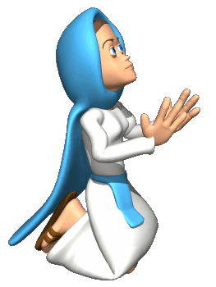
One day, an angel came to Mary.
He said to her, “You’re going to have a baby”

Slide 4
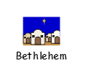
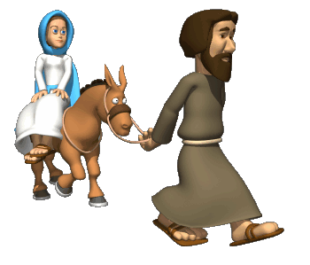
When it was time for the baby to arrive Mary and Joseph travelled to Bethlehem.
It was a long journey so Mary rode on a donkey.

Slide 5
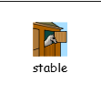
Bethlehem was very busy and Mary and Joseph could not find a place to stay. Oh dear!
Eventually an innkeeper found them a place to rest in his stable.

Slide 6
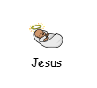
It was in this stable that the baby was born. His name was Jesus.

Slide 7
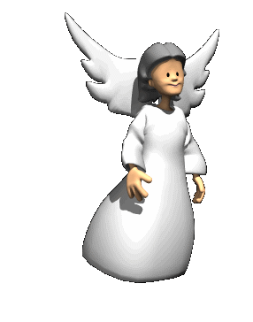
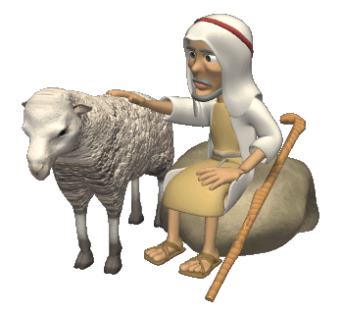
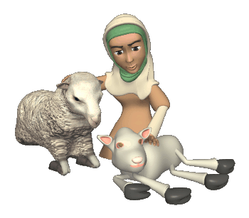
At the same time, sitting on a hillside watching their sheep, were shepherds.
An angel appeared in the sky. She said, “Go to Bethlehem. You will find a baby who is the Son of God. His name is Jesus

Slide 8
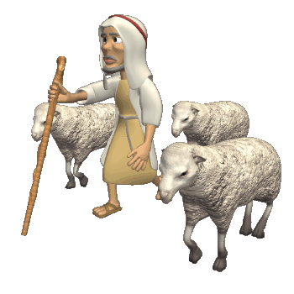
The shepherds walked to Bethlehem.

Slide 9
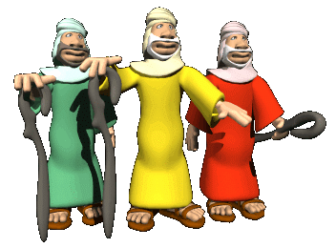
Far away, in the East, three wise men saw a very bright star.
They knew it meant that a new King had been born and followed the star to find him.

Slide 10
The star led them all the way to Bethlehem.

Slide 11
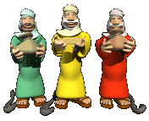
The wise men brought the Baby Jesus gifts of Gold
Frankincense
and Myrrh

Slide 12
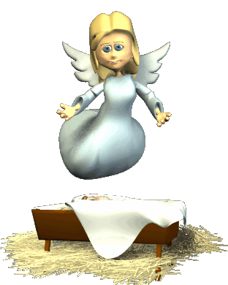
And ever since that day, Christians, all over the world, have celebrated Jesus’ birthday.
It’s Christmas!
Christmas!

