Slide 1
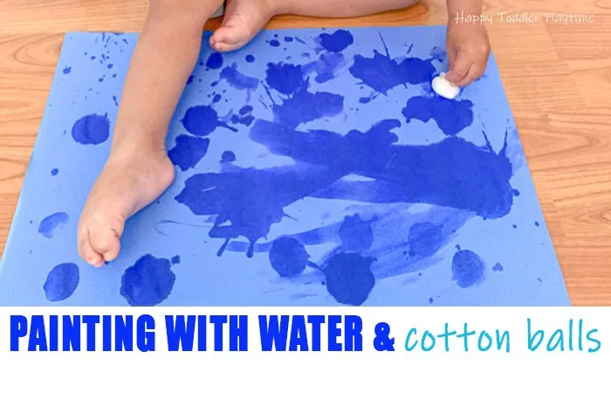
What you need:
Paper
Cotton wool
Water
Liquid Paint – optional

Slide 2
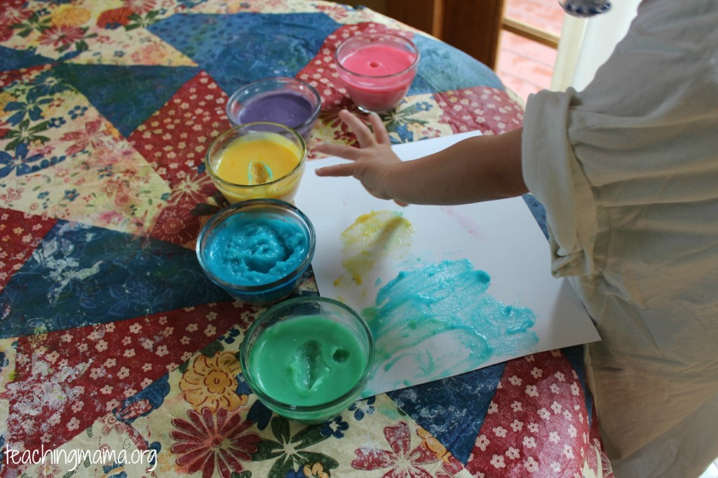
What you need:
Cold and hot water
Any flour
Food colouring
Optional – salt, sugar to taste
Pour 1 cup of cold water and 1 cup of flour into a pan. Gradually add 3 cups of boiling water to the mix. Stir over heat until it boils. Take off the heat and let it cool. Then divide the mixture into bowls and add food colouring. Store in airtight container.
Edible finger paint

Slide 3
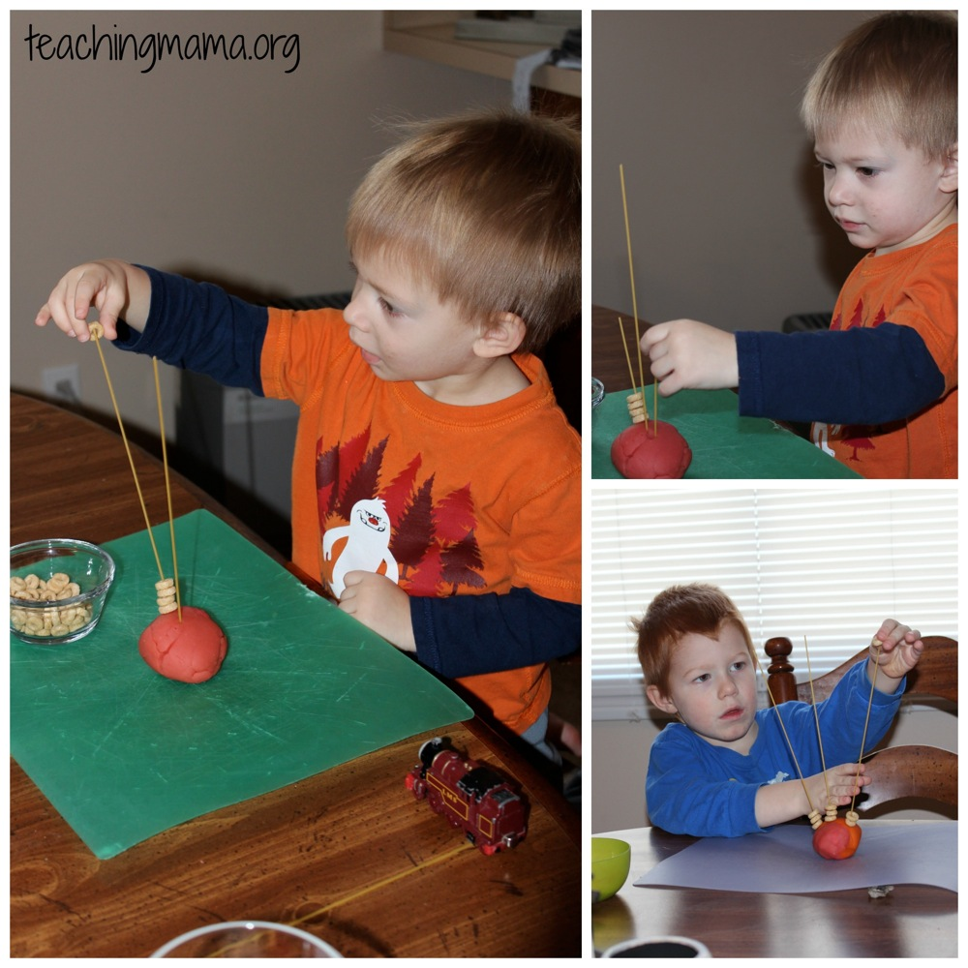
What you need:
Cheerios
Dry spaghetti
Play doh

Slide 4
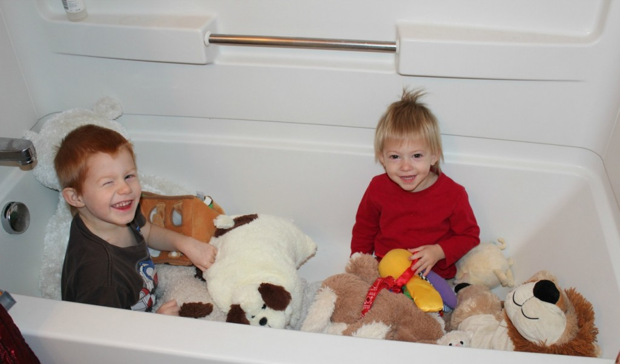
What you need:
Bath tub
Soft toys
Idea – Noah’s Ark,
Pet shop, Vet
Home for our pets and soft toys

Slide 5
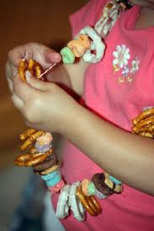
What you need:
Cheerios
Pretzel
Popcorn
String
Needle – depending on items
being used.
Edible jewellery

Slide 6
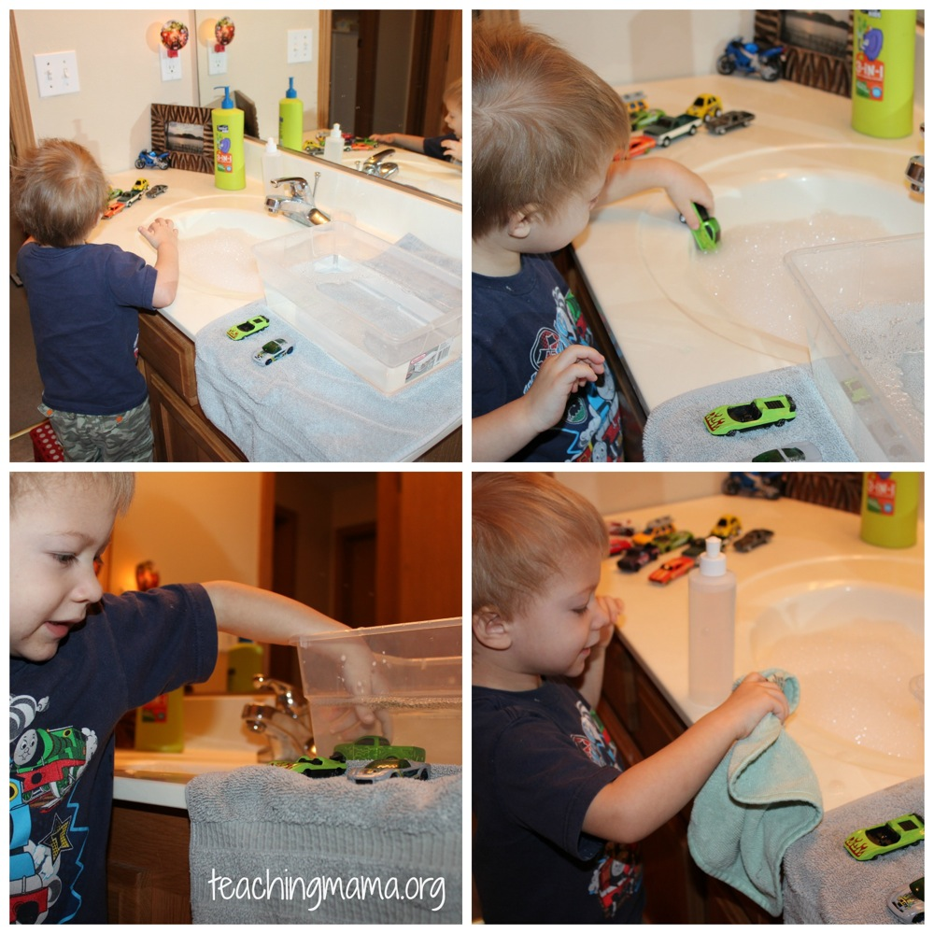
What you need:
Toy cars
Skin friendly soap
Water
Towel
Car Wash

Slide 7
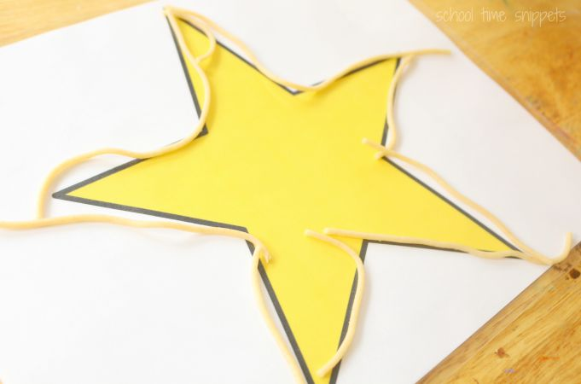
What you need:
Cooked spaghetti
Shapes – these can
be hand drawn
Sensory Spaghetti Shapes

