Slide 1
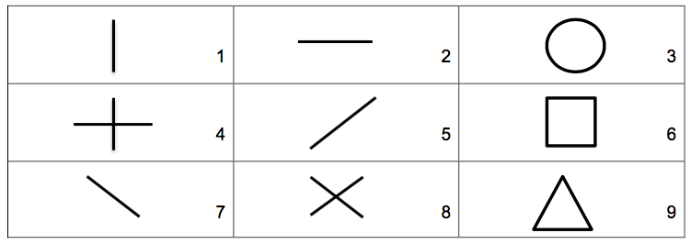

Slide 2
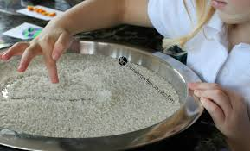
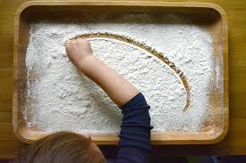
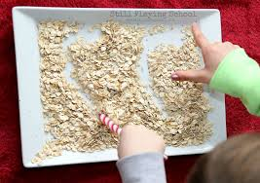
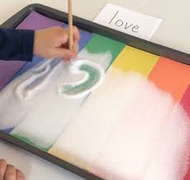
Sensory Mark Making
Rice
Flour
Oats
You will need:
Tray
Choose one item to add
A shape for your child to copy
Paintbrush, straw, pencil to mark make with if your child does not want to use their finger

